Slide 1
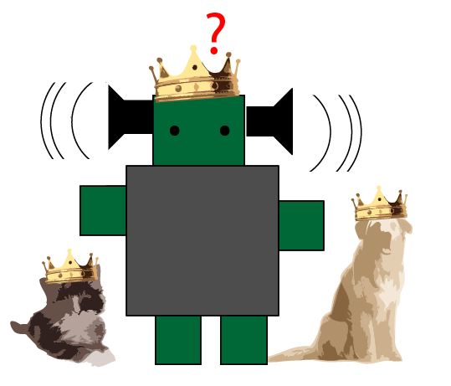


HCIM Capstone Project Pano Papadatos Mona Leigh Guha Tamara Clegg
Clinky the Robot: Preliminary Programming for Preschoolers

Slide 2
Clinky the Robot
Problem
Young children are left out of consideration in Computer Science learning

Slide 3
Clinky the Robot
Why is that a problem? (Motivation)
Harnessing the full potential of computers^{[1]}
Debugging skills are beneficial to everyone^{[2, 3, 4]}
Computer Science: Not the most diverse field^{[5, 6]}

Slide 4
Clinky the Robot
Can they do it?
Comfortable with computers^{[1]}
Independent in their exploration processes^{[2]}
Developmentally Appropriate^{[3]}
Children want to program^{[4]}

Slide 5
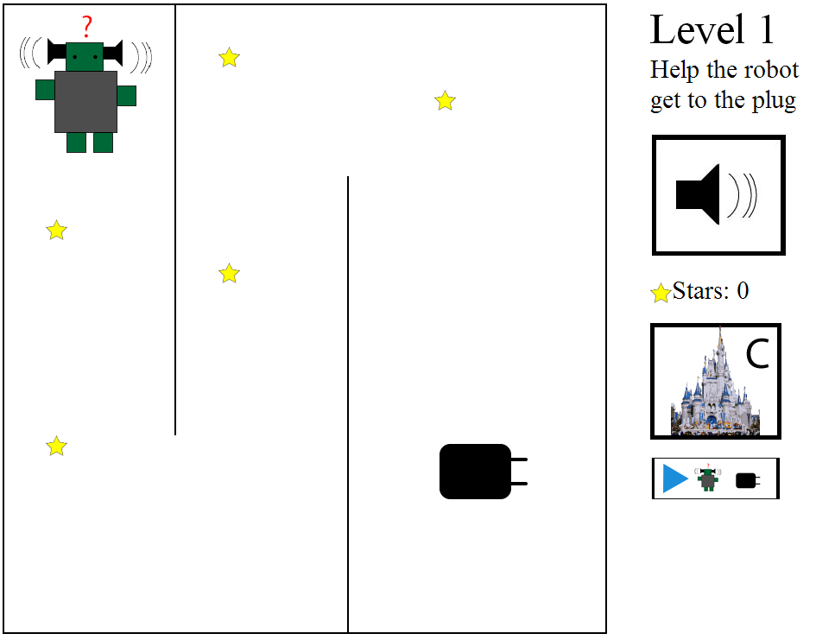
Clinky the Robot
Solution (Product)
iPad application to help young children (3-5) develop programming skills
Touch screens
Easy to use – Soon in classrooms – Easily available

Slide 6
Clinky the Robot
Related Work
Guidelines Content: Kahn & Morgado (Cookbook: 3-5)
Interaction: McKnight & Fitton (Touch Screens)
Activity: Lin & Liu (Child-adult Collaboration)
Other Technologies (>5 years old) Logo & sons, Scratch, Toontalk, Alice, Move the Turtle
Limitation of the field The bulk of the research is for older children and not on touch screens

Slide 7
Clinky the Robot
Related Concepts
Morgado and Cruz , Wyeth, Barr and Stephenson
Parallel Execution
Compound Procedures
Syntax and functionality
Specific Outcomes
Reusing parts
Parameter Passing
Debugging
Planning
Alternative solutions

Slide 8
Clinky the Robot
Design Approach
Cooperative Inquiry Techniques
Nothing Tangible
Literature Guidelines & Concepts
Implementation
Participatory Design
Kidsteam
Formative Evaluation
Wireframing
CYC
Experts
Children

Slide 9
Clinky the Robot
Kidsteam
Children-Adult Design Partnership 7 Adults, 8 Children, ages 7-11
Session 1: Robot activity and drawing (1h)
Goal: Initial Wireframe, Lots of ideas
Analysis: Big ideas, Debriefing, Observing themes
Results: Game
Separate levels
Robots & Castles
Customizability & Upgrades
Collecting Items

Slide 10
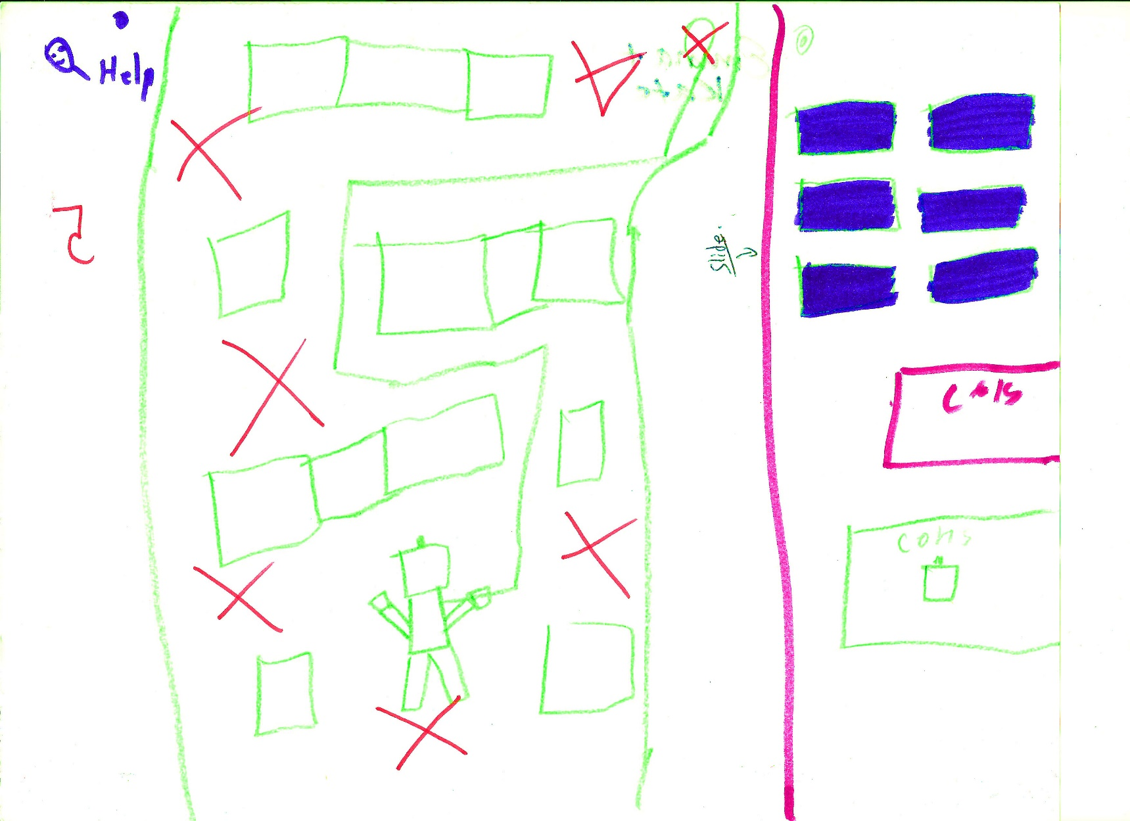
Drawing of the Application (Session 1)

Slide 11
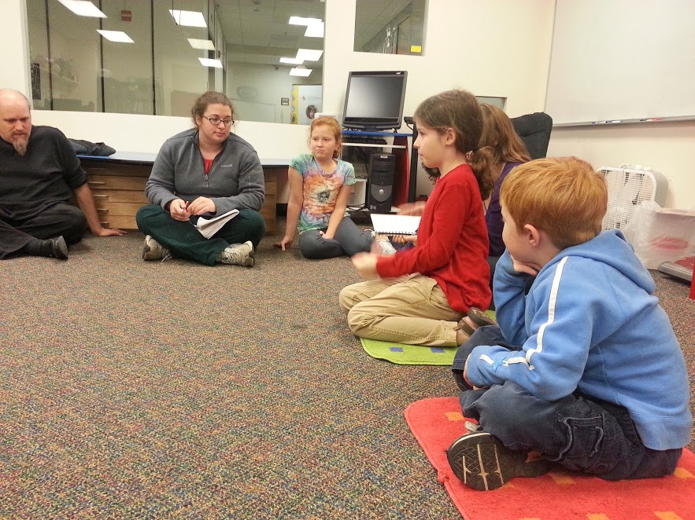
Circle Time!

Slide 12

Clinky the Robot
Kidsteam – Layered Elaboration
Session 2: Rapid Iterations & Rotations (1h)
Goal: Brainstorm and build on the wireframe
Analysis: Themes – Notes & Designs
Results: Animals
Personal Experience
Positive Feedback
Currency
Surprises

Slide 13
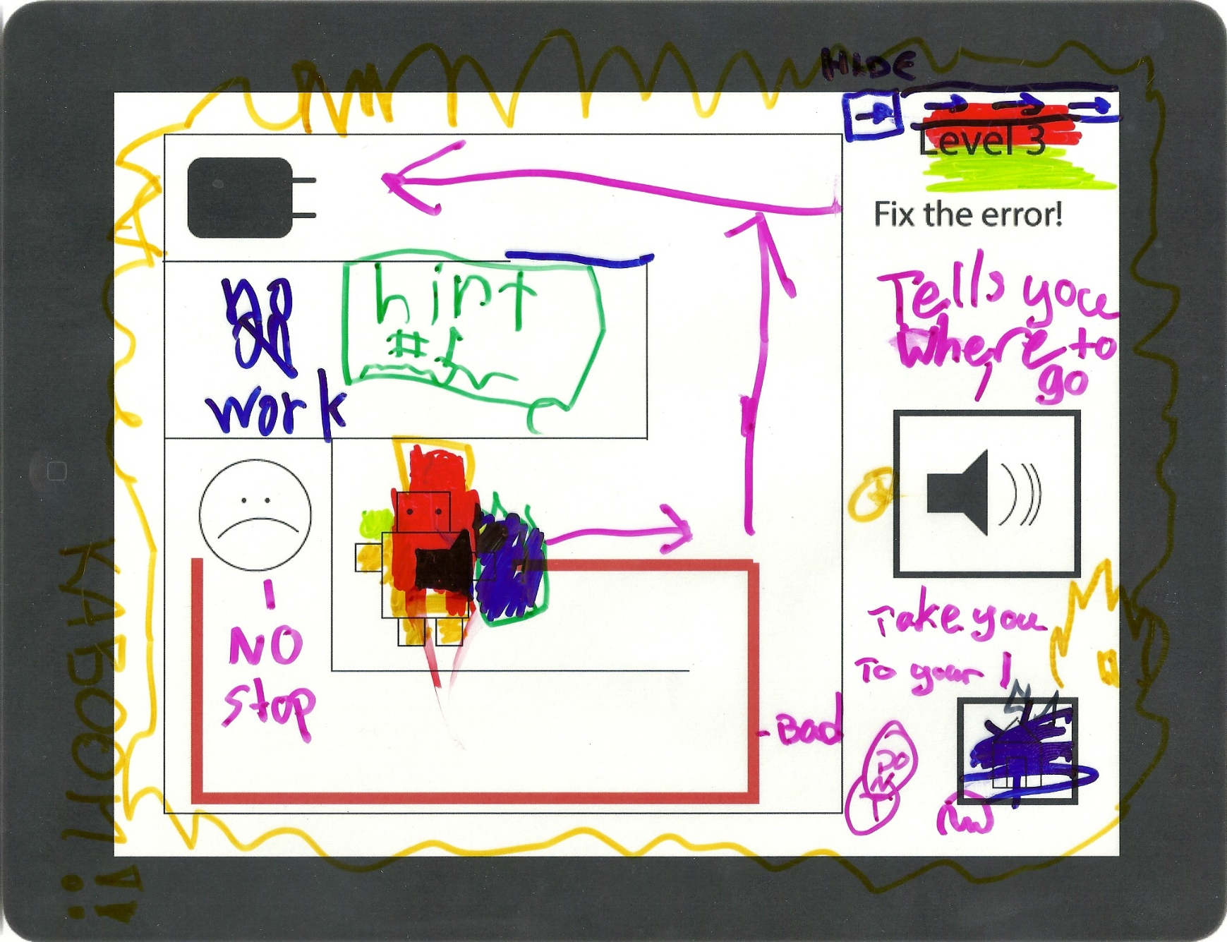
Layered Elaboration design

Slide 14
Clinky the Robot
Prototype (Demo)
5 levels
e.g. Planning, Debugging, Parallel execution, Syntax and Semantics, Compound Procedures…
Motivation
Robot & Castle
Stars as Currency
Upgrades

Slide 15
Clinky the Robot
Formative Evaluation - Experts
Sessions 3 & 4: Interviews - Teachers of 3 & 4, 5 (20m)
Goal: Quality of interactions & learning
Results: Age Appropriate (almost)
Repeating
Practical Guidelines
>Touch interactions, Instructions
Guided VS Independent

Slide 16
Clinky the Robot
Formative Evaluation - Children
Sessions 5, 6 & 8: (20m) 6 Children in pairs of two (3 & 5, 4 & 4, 4 & 4)
Goal: Formative evaluation (Usability & Challenges)
Results: What the teachers said
5/5! ☺
Level 4
Drawing
Expectations
Castle and stars
Replaying

Slide 17
Clinky the Robot
Discussion
Children enjoy programming-like activities:
they can enrich the field of Computer Science
How do we integrate this in preschool education?
How do we scaffold the transition?
How do we design a guided activity?

Slide 18
Clinky the Robot
Conclusion
The children liked it!
They wanted to play it again
The process of helping them learn is complicated
Children change a lot between 3 and 5

Slide 19
Clinky the Robot
Limitations
Not final
Evaluating learning outcomes
Not enough levels
Structuring the learning

Slide 20
Clinky the Robot
Future Work
Designing for 3, 4, 5 and 5+
Implementing Repetition
How do concepts evolve over time
Designing for independent VS guided
Improving Usability (instructions and interactions)

Slide 21
Clinky the Robot
Acknowledgements
Special thanks to:
Mona Leigh Guha & Tammy Clegg
Leah Findlater
Kidsteam
CYC Faculty, Staff & Children
My Classmates
HCIL

